Slide 1
LHC-201 LED Electrical Wiring Routing Details
OpenAg, MIT Media Lab
By Eugene Zeleny
Oct 30th, 2019

Slide 2
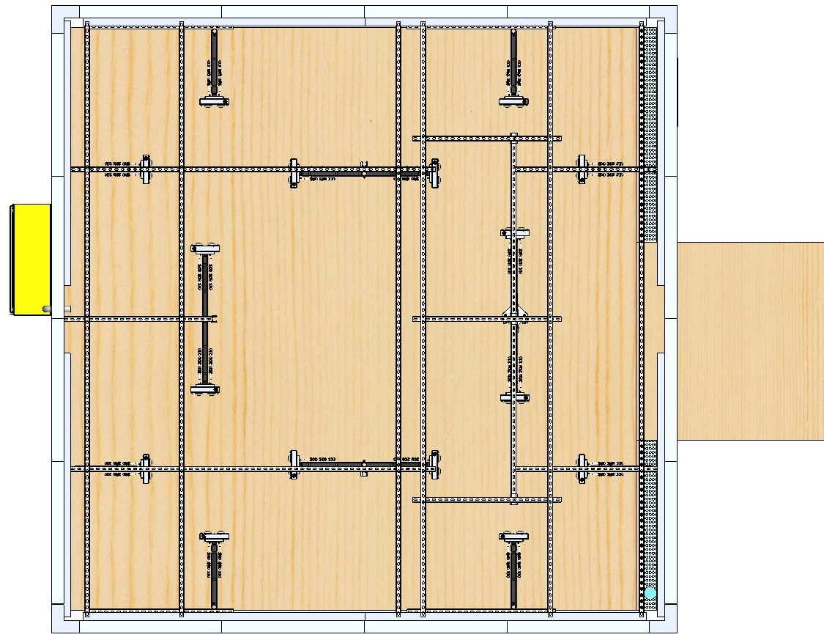
LED Drivers
Enclosure
Wire Routing Path
All wires to be routed vertically up Strut Channel to the Strut Channel Support Structure, then routed as suggested

